Slide 1
Principles and Roots of Quantum Computing

Slide 2
Before we get started
“Before we get started, let’s make sure that we’ve all left our human-sized physical intuition at the door, and let us be ready to trust in the formalism that we are about to introduce. Just follow the mathematics; they will never lead you astray!”

Slide 3
The Roots of Quantum Computing
Quantum Computing is grounded in quantum mechanics
Quantum mechanics focuses on the behaviors and mechanics of very small miniscule particles such as photons, electrons and similar subatomic components
the key features to quantum mechanics are quantization, uncertainty, and coherence.
These principles apply to fundamental particles .

Slide 4
Quantization, Uncertainty, Coherence
Quantization means the universe is “grainy” — space, time, matter, and energy are made up of discrete, indivisible units, much like tiny grains or particles that can’t be subdivided. For instance, the electrons circling the nucleus of an atom can be in any of four orbitals around the nucleus, representing from one, two, three, or four units of energy each.
Uncertainty means that we can’t know both the location and momentum of a fundamental particle at the same time; the more closely we measure one, the more uncertain we are about the other. As a result, electron orbitals are usually represented as clouds around the nucleus, reflecting our knowledge as to where the electron might be and the uncertainty around its exact location at any specific time.
Coherence means that a fundamental particle is free of interaction or measurement, and therefore able to support superposition and entanglement (described later). Protecting each qubit from noise — such as vibration, heat, or changing electromagnetic fields — keeps the fundamental particle at its core coherent.

Slide 5
Coherence
Quantum coherence is a fundamental property of quantum systems that allows them to maintain superpositions of states, enabling particles to exhibit wave-like behaviors and interference phenomena.
It is at the heart of many uniquely quantum mechanical effects, underpinning technologies such as quantum computing, quantum sensing, and secure quantum communication.

Slide 6
Definition of Coherence
Core Definition
In quantum mechanics:
Particles like electrons, photons, or atoms are described by a wavefunction, which encodes the probabilities of all possible states the particle can occupy.
Quantum coherence refers to the fixed phase relationships between components of this wavefunction. These phase relationships allow different possible states to interfere constructively or destructively.
When coherence is present, a quantum system can exist in multiple states simultaneously (superposition). If coherence is lost, the system collapses into a definite state, a process called decoherence.
Analogy: In classical waves, two sound waves can reinforce or cancel each other depending on their relative phases. Similarly, in quantum mechanics, the “waves” forming a particle’s wavefunction interfere according to their relative phases.

Slide 7
Early Theoretical Roots
Early Theoretical Roots
1900 - Planck's Hypothesis:
Max Planck introduced the concept of quantization of energy, marking the birth of quantum mechanics.
1920s - Quantum Mechanics Foundations:
Development of foundational quantum mechanics by Werner Heisenberg, Erwin Schrödinger, Paul Dirac, and others.
1935 - Einstein-Podolsky-Rosen (EPR) Paradox:
Discussion of quantum entanglement, a phenomenon fundamental to quantum computing.
1936 - Turing Machine:
Alan Turing introduced the Turing Machine, laying the groundwork for classical computation theory.

Slide 8
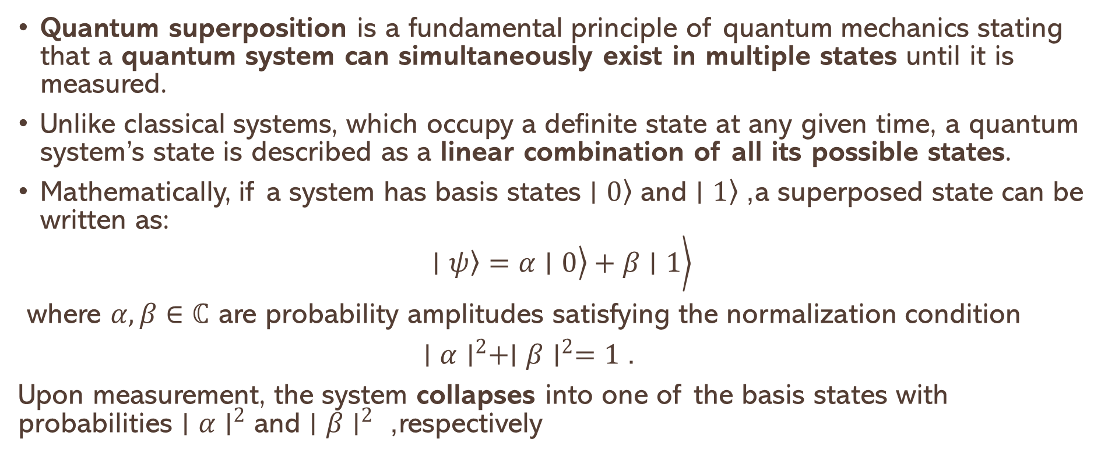
Superposition
Quantum superposition is a fundamental principle of quantum mechanics stating that a quantum system can simultaneously exist in multiple states until it is measured.
Unlike classical systems, which occupy a definite state at any given time, a quantum system’s state is described as a linear combination of all its possible states.
Mathematically, if a system has basis states $\left.∣0\right\rangle$ and $\left.∣1\right\rangle$, a superposed state can be written as:
$$\left.\left.\left.∣ψ\right\rangle =α∣0\right\rangle +β∣1\right\rangle$$
where $α,β∈ℂ$ are probability amplitudes satisfying the normalization condition
$∣α∣^{2}+∣β∣^{2}=1$.
Upon measurement, the system collapses into one of the basis states with probabilities $∣α∣^{2}$ and $∣β∣^{2}$ , respectively

Slide 9
Quantum Entanglement
Quantum entanglement is a phenomenon in quantum physics where two or more particles become connected in such a way that the state of one particle instantly influences the state of the other, no matter how far apart they are.
Key Points:
Connection Beyond Distance: If two particles are entangled, measuring a property (like spin or polarization) of one particle immediately determines the corresponding property of the other, even if they are light-years apart.
Shared Quantum State: Entangled particles share a single quantum state. They cannot be described independently; their properties are linked.
Counterintuitive Behavior: This seems to violate common sense, because the effect is instantaneous. However, it does not allow faster-than-light communication, but it does challenge classical ideas of locality.

Slide 10
Quantum Interference
Quantum interference is a fundamental phenomenon in quantum mechanics where the probability amplitudes of quantum states combine—either constructively or destructively—to influence the likelihood of outcomes. Unlike classical interference, which deals with overlapping physical waves (like sound or water), quantum interference arises from the wave-like behavior of particles such as electrons, photons, and even atoms.
In quantum theory, particles are described by wavefunctions, which contain complex-valued probability amplitudes. When a quantum system can evolve along multiple possible paths—such as going through two slits in a barrier—each path has an associated amplitude. These amplitudes can interfere when the paths are indistinguishable, meaning we cannot tell which path the particle actually took.

Slide 11
Constructive and destructive Interference
Constructive interference happens when the amplitudes reinforce each other, increasing the probability of a particular outcome.
Destructive interference occurs when amplitudes cancel out, reducing or even eliminating the chance of an outcome.
This interference of probabilities—not just measurable properties—leads to surprising results that defy classical intuition. It's what gives quantum mechanics its strange and powerful nature.
In short, Quantum interference isn't just particles "bumping into each other"—it's the result of probability waves interacting in a way that determines what we ultimately observe.
This principle underpins many famous quantum experiments and is one of the core features that enable quantum computers to work. Without quantum interference, quantum computing would be no more powerful than classical computing

Slide 12
Quantum Pertiles wave behavior
Quantum physics is the branch of science that explores the tiniest building blocks of reality — atoms, electrons, photons, and even smaller particles.
At this microscopic scale, the universe behaves very differently than it does in our everyday experience. Instead of moving predictably like billiard balls, particles exist in a blur of possibilities, waves, and probabilities.
Central to understanding this strange realm is the concept of the wave function.
The wave function is a mathematical tool that encapsulates everything we can know about a quantum system. But what exactly is a wave function? How does it shape our understanding of reality? And why does it make the universe so wonderfully weird?

Slide 13
What is a wave function
At its core, a wave function is a complex-valued mathematical function, typically denoted by the Greek letter ψ (psi). It describes the quantum state of a system — be it a single particle, like an electron, or an entire collection of particles.
Unlike classical physics, where a particle has a definite position and momentum at every instant, quantum mechanics tells us that particles exist in a cloud of possibilities. The wave function encapsulates all these possibilities simultaneously.
More precisely, the wave function assigns a complex number to every possible configuration of the system. The magnitude squared of this number, |ψ|², gives the probability density of finding the particle in a particular place or state when a measurement is made. This probabilistic interpretation was first proposed by Max Born and remains a cornerstone of quantum mechanics.
In simpler terms, if you imagine the wave function as a “wave” stretching across space, the height of this wave at any point indicates how likely you are to find the particle there when you look. High peaks correspond to high probabilities; valleys correspond to low probabilities.

Slide 14
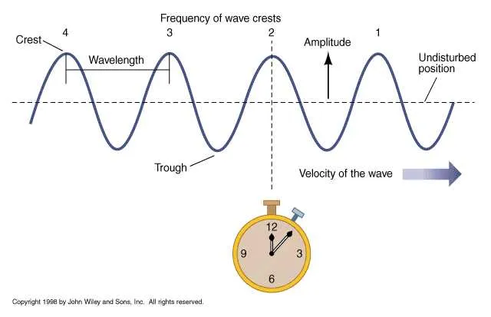
Wave Parameters

Slide 15
Mid-20th Century:
Seeds of Quantum Computation
1960s - Superposition and Quantum Systems:
Researchers began exploring superposition and its implications for computation.
1980 - Feynman's Vision:
Richard Feynman proposed the idea of quantum computers to simulate quantum systems, emphasizing that classical computers struggle with quantum phenomena.
1985 - Deutsch's Quantum Turing Machine:
David Deutsch formulated the concept of a quantum Turing machine and showed how it could perform any physically realizable computation.

Slide 16
1990s: Early Algorithms and Experimental Progress
1990s: Early Algorithms and Experimental Progress
1994 - Shor's Algorithm:
Peter Shor developed a quantum algorithm for factoring integers exponentially faster than classical algorithms, sparking interest in quantum computing.
1995 - Quantum Error Correction:
Shor and Andrew Steane independently proposed quantum error correction techniques to combat decoherence.
10. 1996 - Grover's Algorithm:
Lov Grover introduced a quantum algorithm for searching unsorted databases quadratically faster than classical methods.
11. 1998 - First Experimental Quantum Computer:
IBM and Stanford researchers built a 2-qubit quantum computer using nuclear magnetic resonance (NMR).

Slide 17
2000s: Building Blocks of Scalable Systems
2000s: Building Blocks of Scalable Systems
12. 2001 - Shor's Algorithm Demonstrated:
A 7-qubit quantum computer executed Shor's algorithm to factorize 151515.
13. 2005 - Quantum Error Corrección Miles tones:
Advances in error correction codes, such as surface codes, laid the groundwork for fault-tolerant quantum computing.
14. 2007 - D-Wave's Quantum Annealing Machine:
D-Wave Systems announced the first commercially available quantum computer based on quantum annealing

Slide 18
2010s: Industry Entry and Quantum Supremacy
2010s: Industry Entry and Quantum Supremacy
15. 2011 - IBM and Google Invest in Quantum:
IBM and Google began significant investments in quantum computing research.
16. 2017 - IBM Q Experience:
IBM made a 5-qubit quantum computer accessible to the public via the cloud.
17. 2019 - Google's Quantum Supremacy:
Google claimed quantum supremacy with their 53-qubit "Sycamore" processor, performing a computation in seconds that would take classical supercomputers thousands of years.

Slide 19
2020s: Commercialization and Scaling
2020s: Commercialization and Scaling
18. 2020 - Quantum Volume and Practical Applications:
IBM introduced the concept of "quantum volume" to measure a quantum computer's capability. Applications in optimization, chemistry, and machine learning gained traction.
19. 2021 - Quantum Advantage Claims:
Companies like Xanadu and Honeywell made advances toward demonstrating quantum advantage.
20. 2022 - Fault-Tolerant Architectures:
Progress in developing error-corrected qubits moved quantum computing closer to scalability.

Slide 20
2020’s ……
23. 2023 - Modular Quantum Systems:
Efforts in modular quantum architectures began to focus on connecting quantum processors to scale systems.
24. 2024 and Beyond:
The quantum computing industry is focused on achieving fault-tolerant quantum computers, integrating quantum computing into hybrid workflows with classical systems, and broadening quantum education.

Slide 21
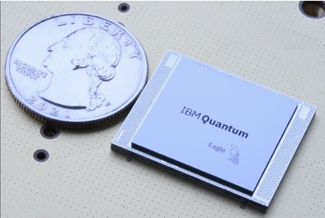
IBM Eagle Quantum Chip

Slide 22
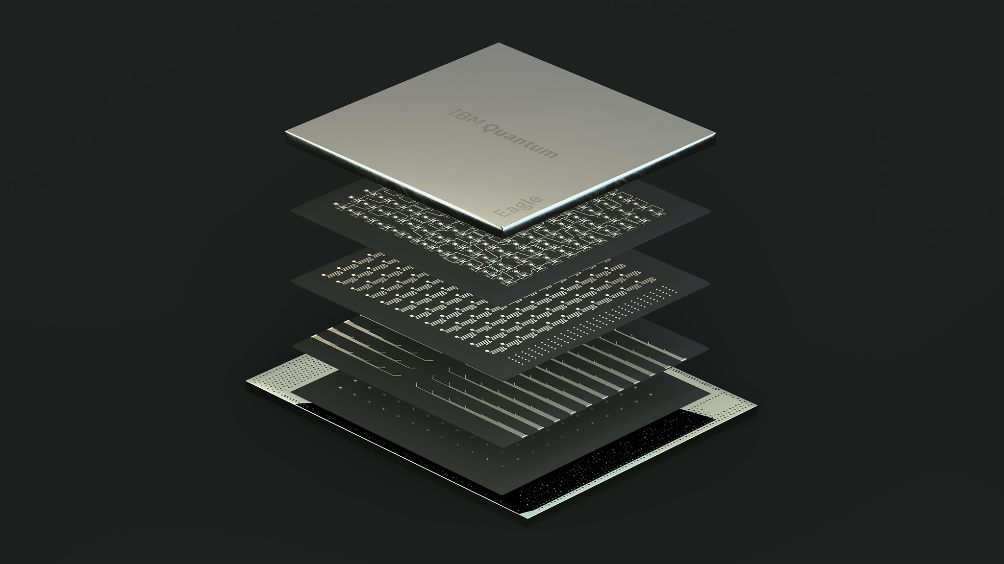
IBM Quantum Chip: Eagle interior -127 Qubits

